Slide 1
Bonsuck Koo
GNC Engineer (Early Career) Panel Interview

Slide 2
Introduction
Name: Bonsuck Koo
Degree: Integrated Master and Bachelor of Science (2024 Dec.)
School: University of Texas at Austin
Hobbies: Visiting National Parks, Listening to Science Podcasts
Obtained American Citizenship in August 2023

Slide 3
Experience overview
NGC engineering internship Sandia National Laboratories (Current)
GNC engineering Internship at Blue Origin (2023 Fall)
Mechanical Engineering Internship at Samsung Austin Semiconductors (2022 Summer)
Co-op at Trane Technologies (2021 Summer and Fall)
Mandatory Korean Military service (2018-2020)
Study emphasis on Dynamics Systems and Control
Master coursework in Controls engineering and aerospace

Slide 4
Why Blue Origin?

Slide 5
Projects

Slide 6
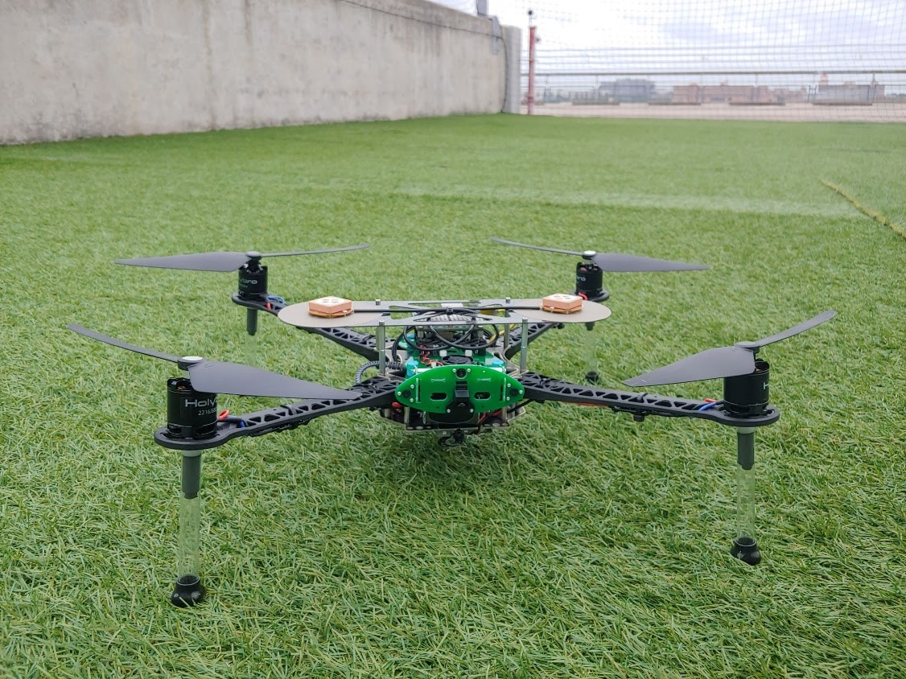

Aerial Robotics (Drone)
2024 Spring (Last Semester)
Team Competition
Team: Three people
Goal:
Create an algorithm to find the fastest routes to the targets
Targets were ballons in a field
Overcome obstacles
The algorithm should work both in simulation and real-life
Each Team were timed on how fast it pops two ballons from a designated starting point and returns to another designated end point.
One of the two teams that successfully flew the drone
2nd Place in class
Source: ASE 497W Todd E. Humphreys; University of Texas at Austin
Notes:
The first project I want to present is the Drone project I did in Aerial Robotics course last semester. This was a team competition that consisted of three people per team. The goal was to create an algorithm for the drone that would find the fastest routes to targets. The targets were balloons placed on a field, which you will see soon. And the drone had to pop the balloons by flying through them to confirm that it reached the targets. There were also imaginary obstacles that the drone had to go around,and lastly the algorithm should have worked both in a simulation environment and in real life.
So for the competition, each team would timed on how fast it pops two ballons from a designated starting point and returns to another desginated end point.
Here you see a picture of the drone, or the quadrotor that we implemented our algorithm on. Here is a picture of my proud teammates!
For spoilers, We were one of the two teams that successfully flew the dorne in real life and ended up placing 2nd in the competition.
Before I begin explaining my work, I will start by showing the result of my team’s work!

Slide 7
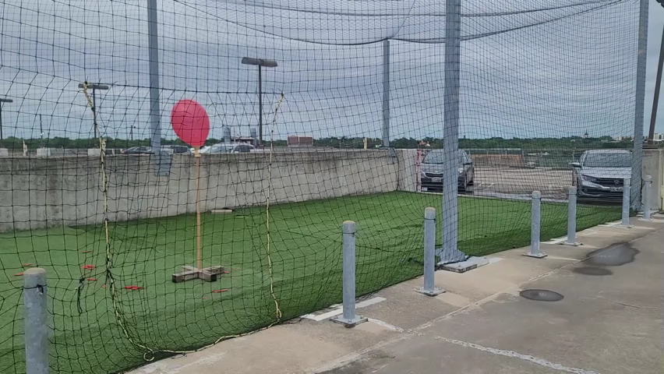
Notes:
So what you see here is the field, which was just a netted area on top of the school’s parking garage. The drone is flying inside the netted area and moves itself towards the ballons. Here you see that it manuevers towards the ground, and that’s because there is an imaginary wall, so it had to go below the wall. There are other imaginary obstacles in this field. And you see that it tries to return to an ending spot by going around obstacles again.

Slide 8
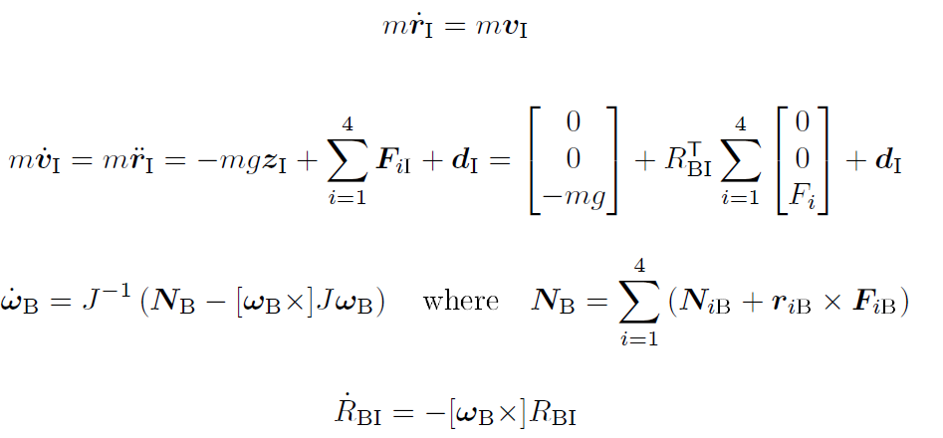

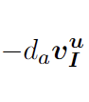
Aerial Robotics (Drone) Quadrotor Dynamics
Disturbance
Force from the Fan
Gravity
Wind Resistance
Torque from propeller acting against the air
Torque from upward thrust
Notes:
Let me call the drone a quadrotor or the quad.
So, before we actually worked on the algorithm, Each of us first developed a simulation that would simulate the Drone’s flight behaviors on MATLAB.
I first modeled the drone’s dynamics with 4 ODE.
The first equation was the velocity, which is just defined here.
The dynamic equation for the acceleration was determined by the forces acting on the drone. Here is the gravity acting on the drone. The second term is the upward force exerted by the fan onto the quad which keeps the drone up in the air, and we have four of those. We have the drag force acting against the motion of the quad at the end. Lastly, any disturbance force was modeled as a noise.
The third equation is for the angular acceleration. This is what you get if you take the derivative of angular velocity. Nb term is the torque combination caused by the propellers. Specifically, NB_i is the torque caused by the propeller acting against the air, so it makes the drone spin on its own axis, like this. The R cross F term is the torque caused by the thrust force that keeps the drone in air, which could make the quad flip over.
Lastly, I have the equation for the change in the attitude matrix. Notice I used the full rotation matrix to avoid singularities or gimbal lock, instead of Euler angles.
Quaternions is another option, but I didn’t have enough time to learn it at the time.

Slide 9
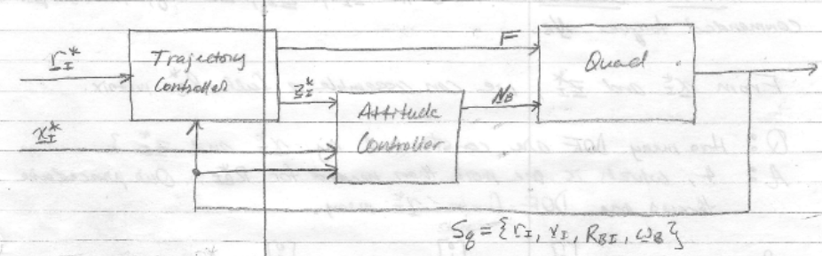
Aerial Robotics (Drone) PD controller
PD Controller
Plant
Reference or desired states are denoted with a star
Source: ASE 497W Todd E. Humphreys; University of Texas at Austin
Notes:
Here is the schematic of the control system I was simulating for. I used two controllers, one for trajectory control and another for an attitude control. PD controllers were implemented for both.

Slide 10
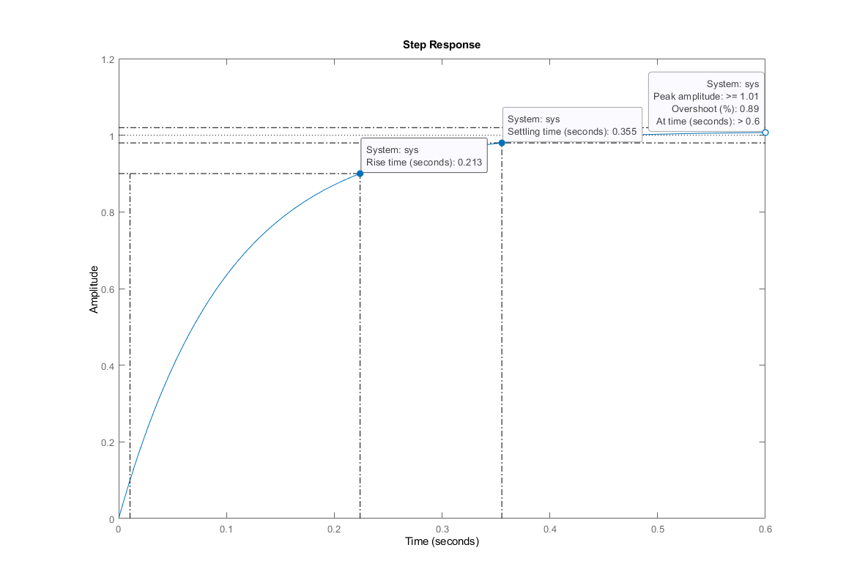
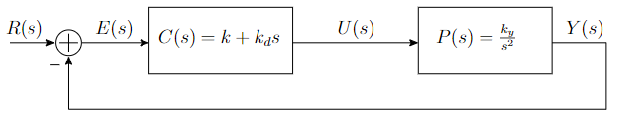
Aerial Robotics (Drone) PD controller
Notes:
But Before actually implementing PD controllers, a basic PD controller in this figure was tuned to see how P and D gains affect the system behavior.
The goal of this exercise was to make the closed loop system’s unit step response to have less than 0.25 seconds
of rise time (Tr), less than 30 % of over shoot (Po), and less than 2 seconds of settling time (Ts) to within 2 % of reference value. The proportional gain, k, and the derivative gain, kd, values that satisfied the desired step response was 1 and 10 respectively. Figure 10 shows the step response of the closed loop system with the gains. It has a rise time of about 0.213 seconds, settling time of 0.355 seconds, and 0.89 % overshoot.
Talk about how does PD affects the behavior*******************

Slide 11
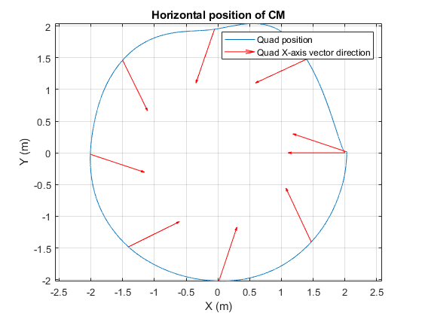
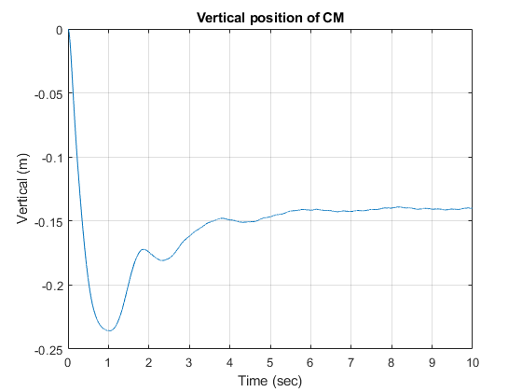
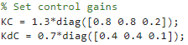
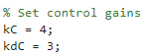
Aerial Robotics (Drone) PD controller
Attitude Controller PD Gains
Trajectory Controller PD Gains
Notes:
The actual tuning of attitude controller was really hard, because P and D gains were in matrix form. I tuned it until the drone followed a desired circular and a designated height as closely as possible in a MATLAB simulation.

Slide 12
Aerial Robotics (Drone) Sensor Modeling
GNSS Measurements
IMU
Camera

